Slide 1
Appendix C
The ColdFire Processor

Slide 2
Appendix Outline
Memory organization and register structure
Addressing modes and types of instructions
Example programs
Extensions for floating-point operations

Slide 3
Memory Organization
Byte-addressable, 32-bit address space
Big-endian addressing scheme
Longword (32-bit), word (16-bit),
and byte (8-bit) sizes for integer data

Slide 4
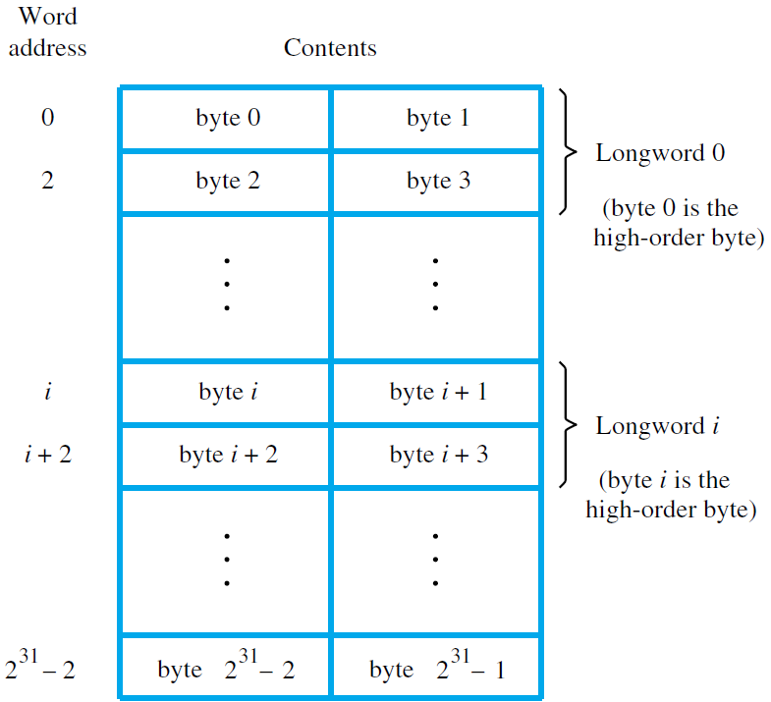

Slide 5
Register Structure
Eight data registers, D0 to D7
Eight address registers, A0 to A7,
and register A7 is the stack pointer (SP)
Status register (SR) with condition codes

Slide 6
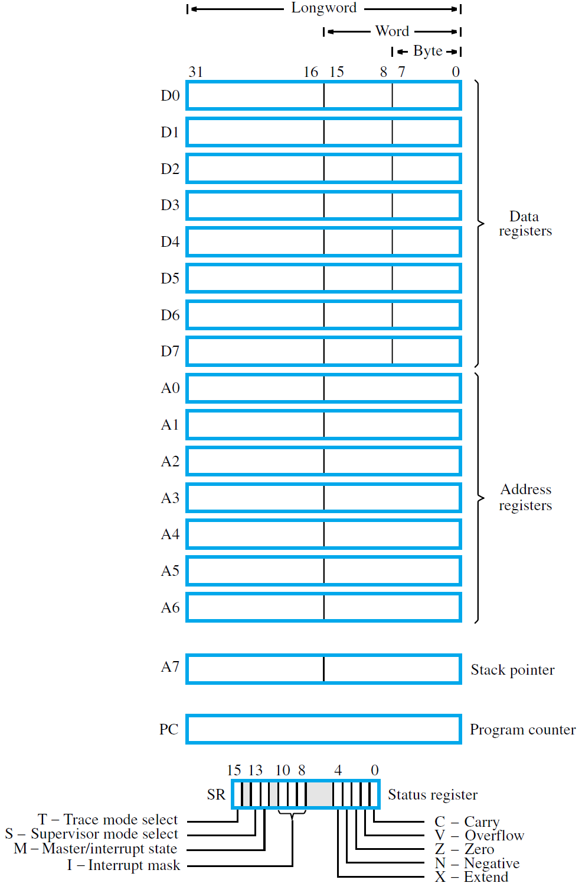


Slide 10
Instructions
One, two, or three consecutive words
OP-code word is first – it specifies operation
Also provides some addressing information; one or two extension words provide more
Most arithmetic and data-transfer instructions have source/destination operands:
OP src, dst
.L, W., or .B suffix for OP code specifies size

Slide 11
Addressing Modes
Immediate, absolute, and register modes
Register indirect mode
Autodecrement and autoincrement modes
Index and PC-relative modes

Slide 12
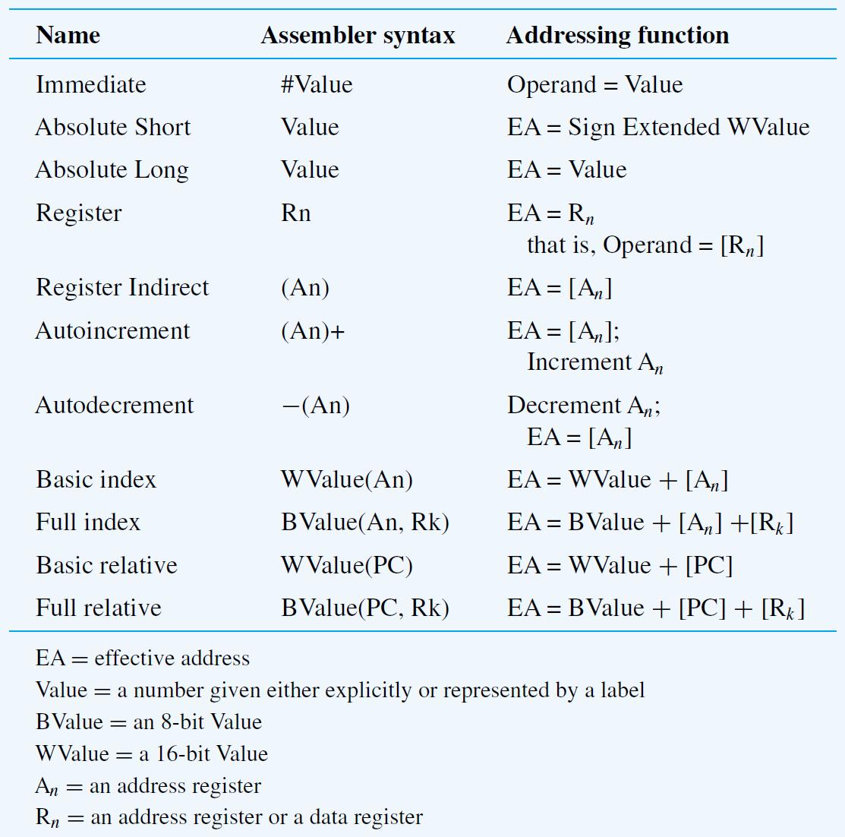

Slide 13
MOVE Instruction
Used to perform transfers between memory, I/O interfaces, and registers
Value being transferred affects N and Z flags
in status register
Byte, word, and longword sizes are permitted
All addressing modes valid for source operand
Some modes not permitted for destination
Some source/dest. mode pairings not valid

Slide 14
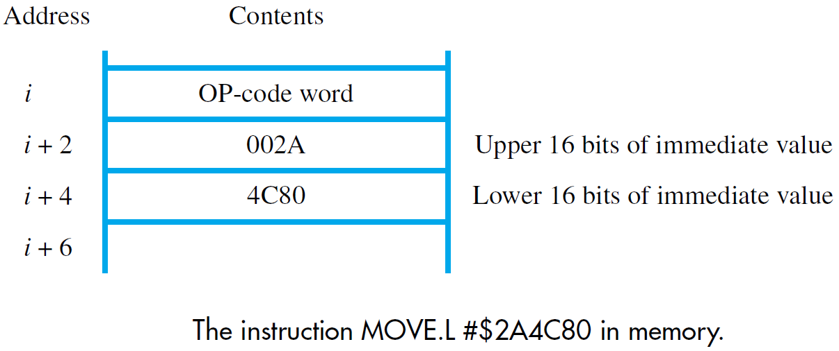

Slide 15
Arithmetic Instructions
Most permit only longword size,
and most require at least one register operand
Addition, subtraction, comparison, negation:
ADD.L, SUB.L, CMP.L, NEG.L
ADDI.L, ADDQ.L for immediate operands
ADDA.L, SUBA.L, CMPA.L for address registers
Arithmetic operations affect condition codes
ADDX.L, SUBX.L, NEGX.L for numbers > 32 bits

Slide 16
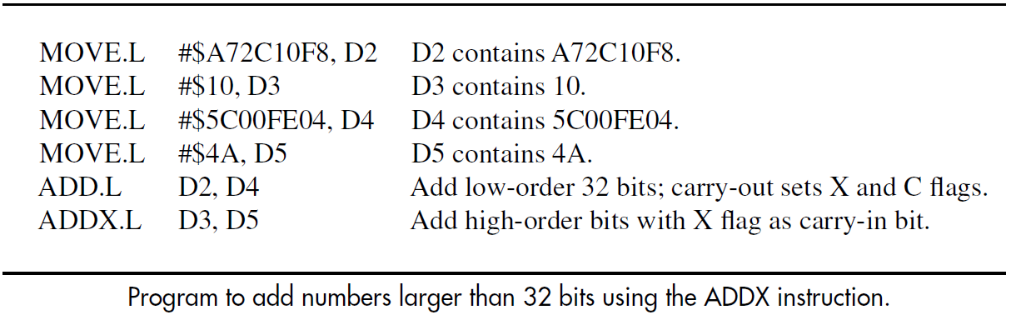

Slide 17
Multiplication and Division
Signed/unsigned multiply of 16-bit numbers,
or 32-bit numbers (where result is truncated)
N and Z flags affected; V and C flags cleared
Signed/unsigned division where divisor is either 16 or 32 bits (dividend is always 32 bits)
For 16-bit divisor, remainder placed in register, but for 32-bit divisor, remainder is discarded
Special instruction gives remainder separately

Slide 18
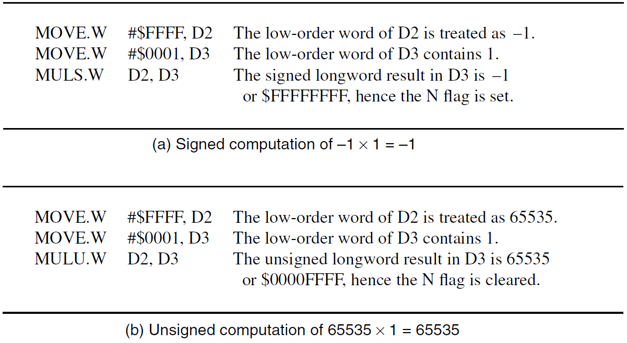

Slide 19
Branch and Jump Instructions
Conditional branches test combinations of condition code flags; e.g., BEQ checks if Z=1
BRA is unconditional branch
Target address for branch computed by
adding signed offset to program counter value
Offset is part of branch instruction encoding
May be 8, 16, or 32 bits in size
Unconditional JMP instruction can specify target address with an addressing mode

Slide 20
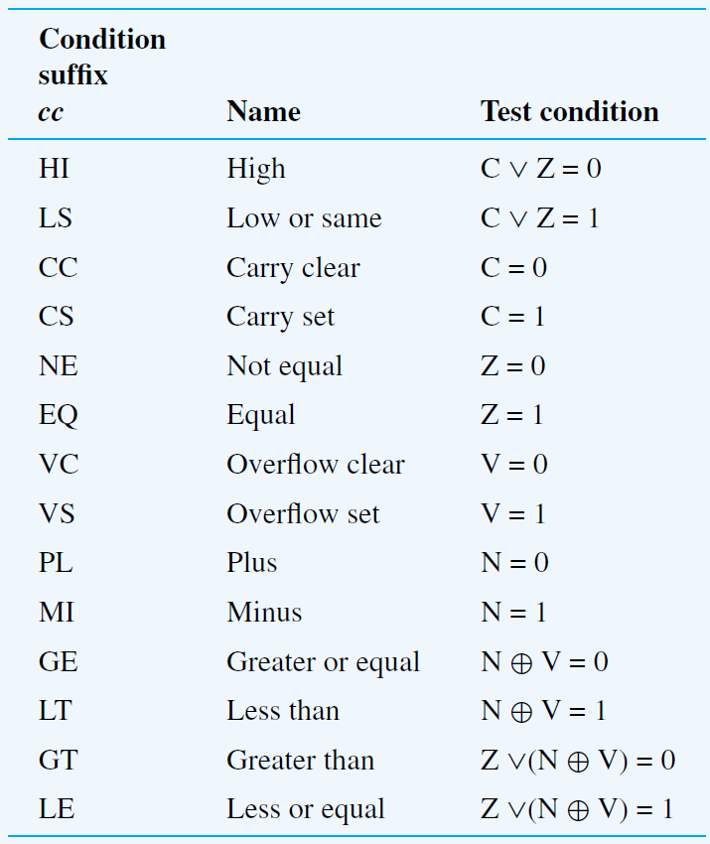

Slide 21
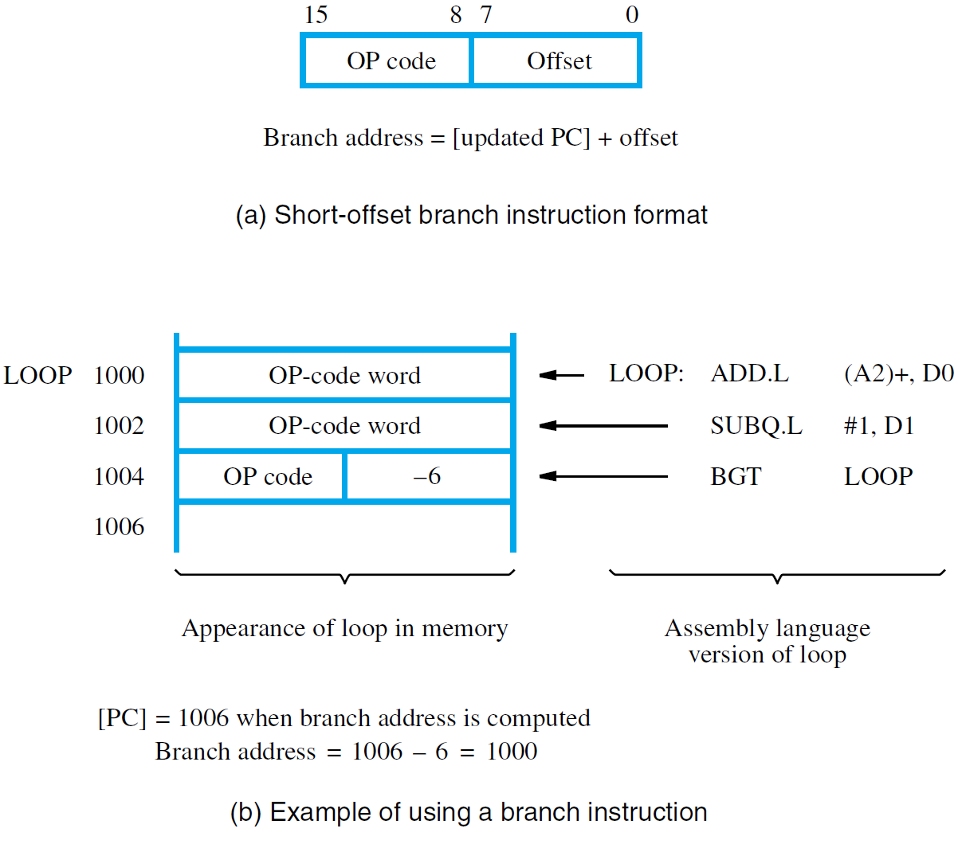

Slide 22
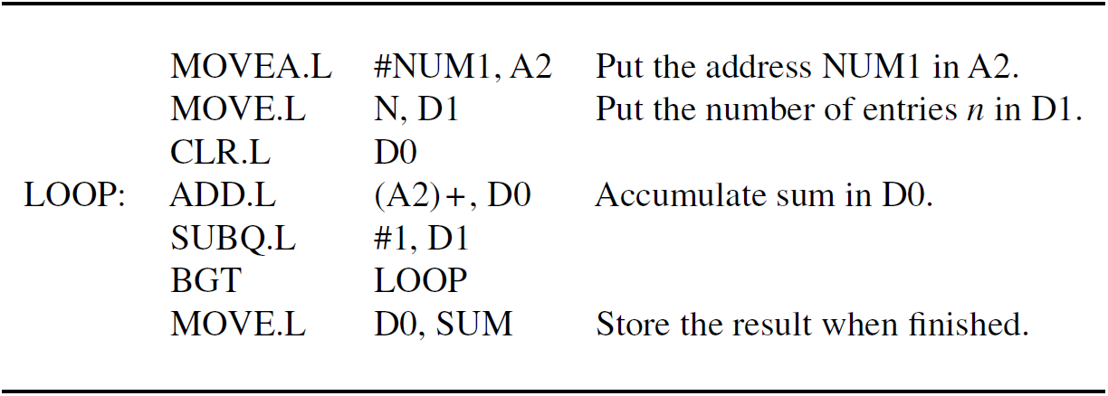

Slide 23
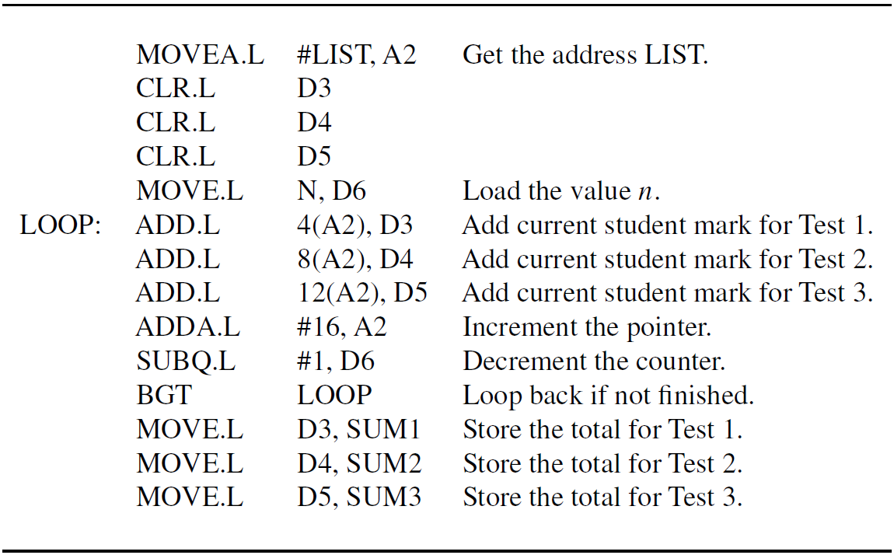

Slide 24
Logic and Shift Instructions
AND.L, OR.L, EOR.L, NOT.L instructions
require at least one data register operand
ANDI.L, ORI.L, EORI.L – immediate src operand
N and Z flags affected; V and C flags cleared
LSL.L, LSR.L, ASL.L, ASR.L instructions require immediate or data register for shift amount
Operand to be shifted is in a data register

Slide 25
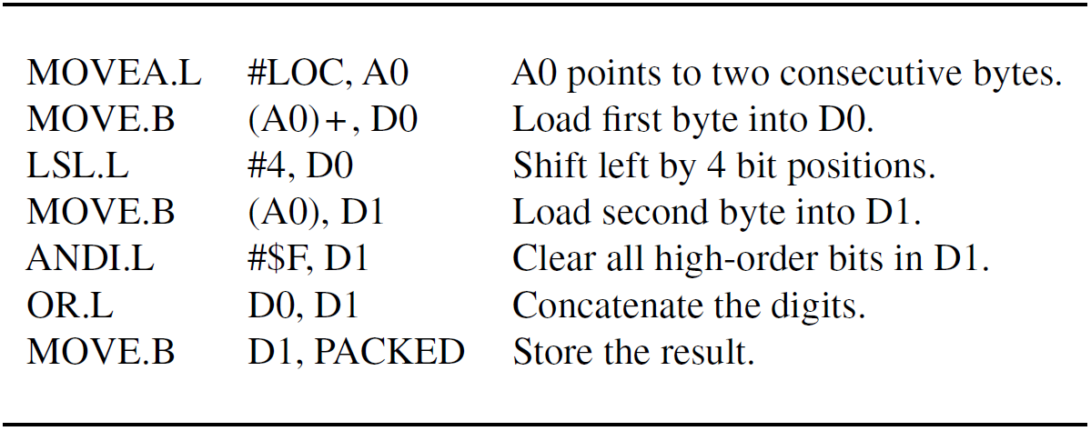

Slide 26
Subroutine Linkage
Address register A7 is the stack pointer (SP)
Subroutine call/return instructions use A7
to automatically save/restore return address
JSR, BSR instructions for subroutine calls
RTS instruction for returning from subroutines
Pass parameters in registers or using stack
If parameters pushed to or popped from stack, register A7 must always be a multiple of 4

Slide 27
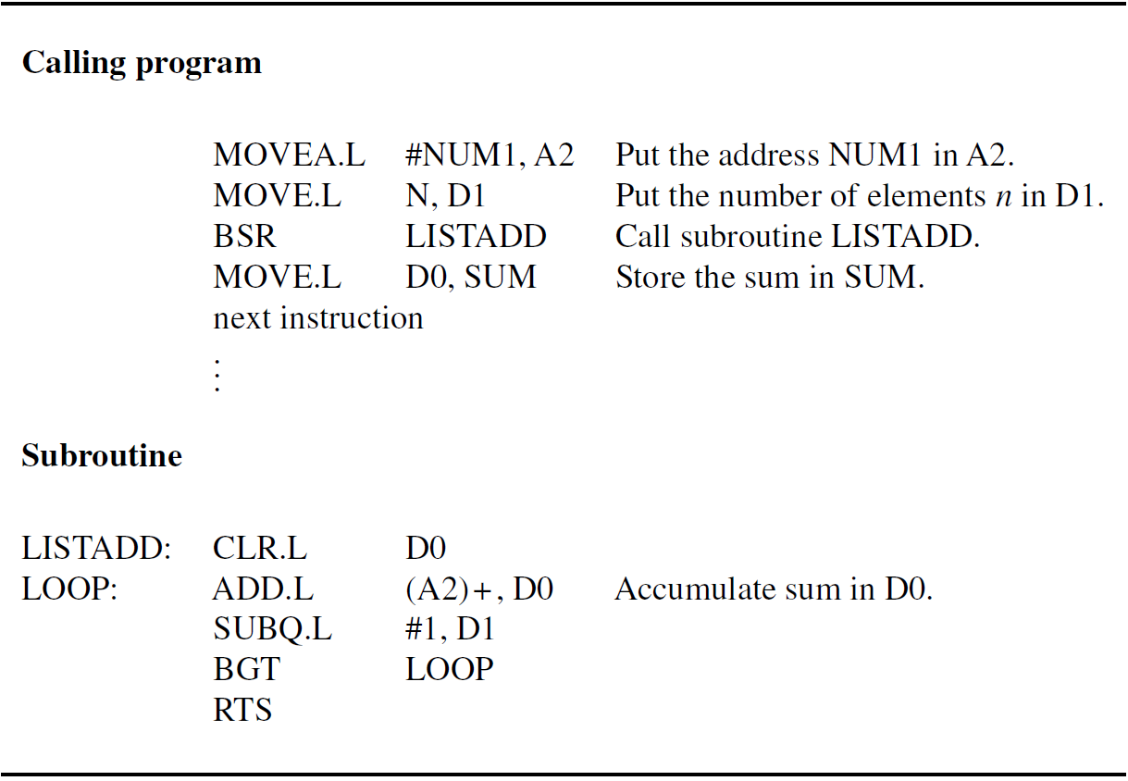

Slide 28
Example Programs
Vector dot product and string search programs have loops that use pointers to access data
Both programs can use autoincrement mode combining memory access and pointer update

Slide 29
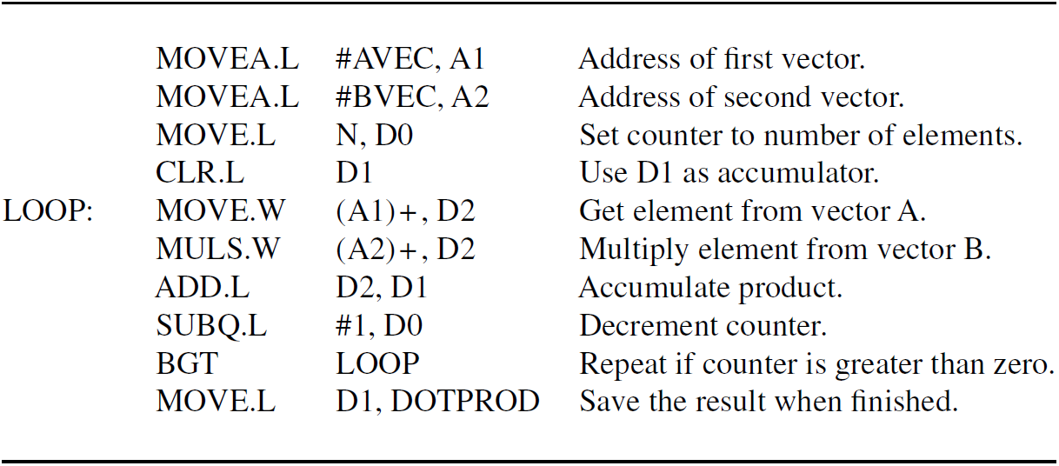

Slide 30
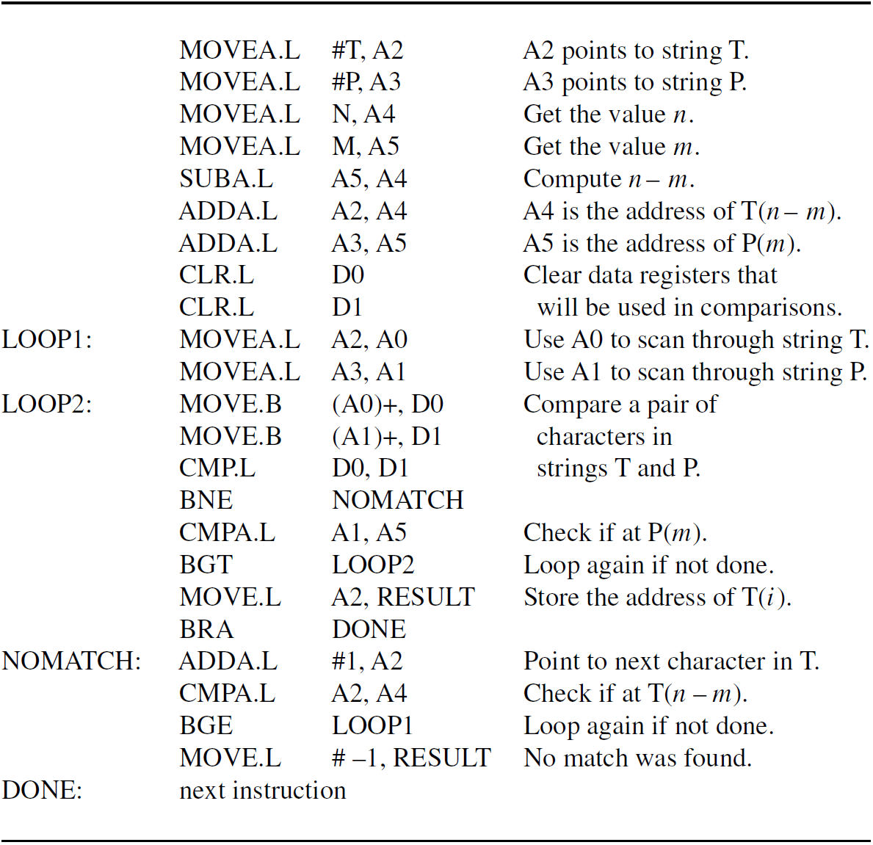

Slide 31
Floating-Point Instructions
Extension of basic ColdFire instruction set
Separate floating-point unit in hardware provides eight dedicated registers, FP0 to FP7
64-bit internal representation and operations
FMOVE instructions use .S or .D to specify single- or double-precision for data transfers
Transfers with .B, .W, or .L involve automatic type conversion to/from integer representation

Slide 32
Floating-Point Instructions
Floating-point unit has its own N and Z flags
Flags affected by data value for FMOVE
when FP register is destination operand
FADD, FSUB, FMUL, FDIV also affect flags
Comparisons use FCMP to set flags
FBcc instructions test flags for branching
Additional instructions: FSQRT, FNEG, FABS

Slide 33
Concluding Remarks
ColdFire is a CISC-style instruction set
Separate sets of data and address registers
Instructions are one, two, or three words
Several addressing modes are supported, including autodecrement and autoincrement
Floating-point instructions use dedicated registers for internal 64-bit operations
Automatic conversion between integer and floating-point representation

